Slide 1
Digital Portfolio
STUDENT NAME: keerthana P
REGISTER NO AND NMID: 2422k0249 and asbru172422k0249
DEPARTMENT: B.sc (Compter science )
COLLEGE: SRI Vasavi College (SFW)
University: Bharathiyar university

Slide 2
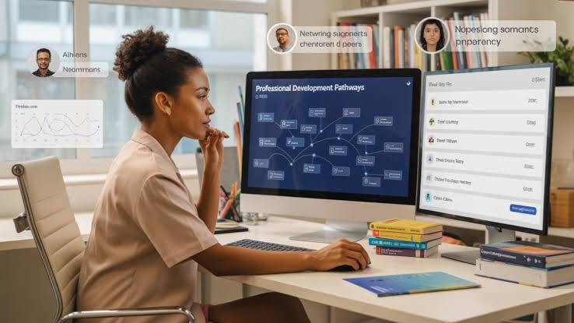
PROJECT TITLE
STUDENT PORTFOLIO

Slide 3


AGENDA
Problem Statement
Project Overview
End Users
Tools and Technologies
Portfolio design and Layout
Features and Functionality
Results and Screenshots
Conclusion
Github Link
3/21/2024 Annual Review

Slide 4

PROBLEM STATEMENT *Highlights academic qualifications, skills, and projects. *Provides an interactive and user-friendly interface. *Acts as a personal branding tool for future opportunities.

Slide 5

PROJECT OVERVIEW
The Student Portfolio Project aims to develop a digital portfolio that effectively showcases a student’s academic achievements, technical skills, certifications, and project work in a well-structured and visually appealing format.
Enabling better self-promotion for internships, jobs, and higher education.
Providing a clean, user-friendly, and accessible interface for viewers.

Slide 6

WHO ARE THE END USERS?
The end users of the Student Portfolio Project are the individuals or groups who will use, view, or benefit from the digital portfolio:
1. Student
2. Recruiters
3. Higher education Institutions
4. Collage faculties

Slide 7

TOOLS AND TECHNIQUES
HTML, CSS (Optional) For customizing the design and styling.
MS PowerPoint : For project presentation and portfolio mockups.
Responsive Design: Ensuring the portfolio is user-friendly and accessible.
Interactive Features : Adding clickable sections for projects, certificates, and achievements.

Slide 8

PORTFOLIO DESIGN AND LAYOUT
Header Section:
Student name, profile photo, and a short introduction.
Navigation Menu :Easy access to different sections like About, Skills, Projects, Achievements, and Contact.
Responsive Layout:Ensures compatibility across devices like laptops, tablets, and mobiles.
Clean and Minimal UI: Focus on readability and neat structure.
8

Slide 9

FEATURES AND FUNCTIONALITY
Personal Information Section:
Displays student details like name, photo, contact info, and bio.
Academic Details:
Highlights educational background, marks, and grades in an organized format.
Skills Showcase:
Lists technical and soft skills with visual representations like progress bars or charts.
Data Visualization:
Uses graphs and charts to represent skills, grades, and achievements.

Slide 10

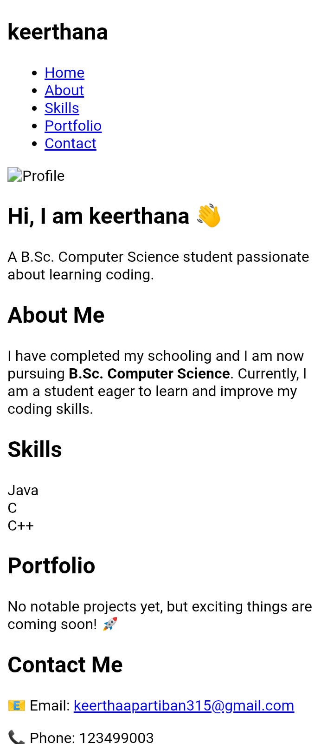
RESULTS AND SCREENSHOTS
Successfully developed a Student Portfolio System that allows students to create, update, and manage their academic and personal details.
10

Slide 11

CONCLUSION
The Student Portfolio System provides an efficient platform for students to showcase their achievements, skills, and projects in an organized manner.
It simplifies profile management and helps students present themselves effectively for placements, internships, and higher studies.
11

Slide 12
GITHUB LINK

